Slide 1
Face Mask Monitoring and Notification System Using Computer Vision and Deep Learning.
PRESENTED BY GROUP 5

Slide 2
OUR TEAM
ROUNAK BANERJEE - 057
RUPAM DASGUPTA - 055
SANDIP GHOSH - 050
SAPTARSHI BANERJEE – 048
RENESA CHAKRABORTY – 061
SHOUVIK NEOGI - 039

Slide 3
CONTENTS
ROADMAP OF THE PROJECT
INTRODUCTION
INSPIRATION AND MARKET ANALYSIS
TECH TOOLS
HOW THIS MODEL WORKS

Slide 4
ROADMAP OF THE PROJECT
SELECTION OF IDEA
LITERATURE SURVEY
DESIGN A FLOWCHART
TESTING, EVALUATING, FIXING ERRORS
IMPLEMENTATION WITH CODE
TASK DIVISION
READY TO DEPLOY

Slide 5
INTRODUCTION

Slide 6
WHAT IS FACE MASK DETECTION ?
FACE MASK DETECTION IS A MODEL WHICH USES ARTIFICAL NETWORK TO RECOGNIZE IF A PERSON IS WEARING A MASK OR NOT.

Slide 7
INSPIRATION AND MARKET ANALYSIS

Slide 8
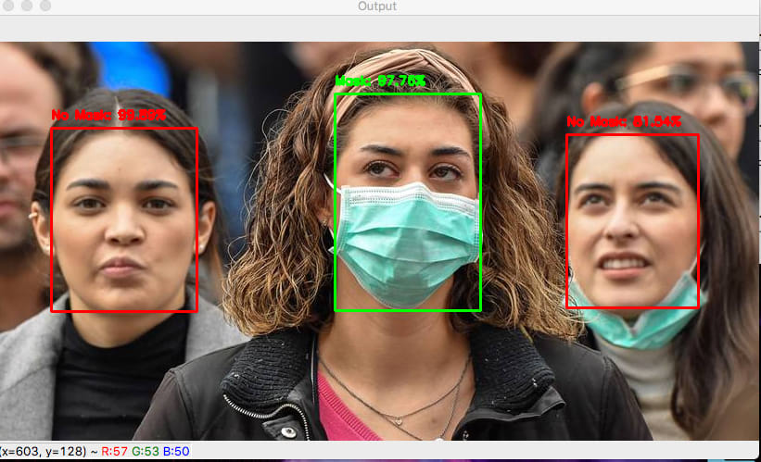
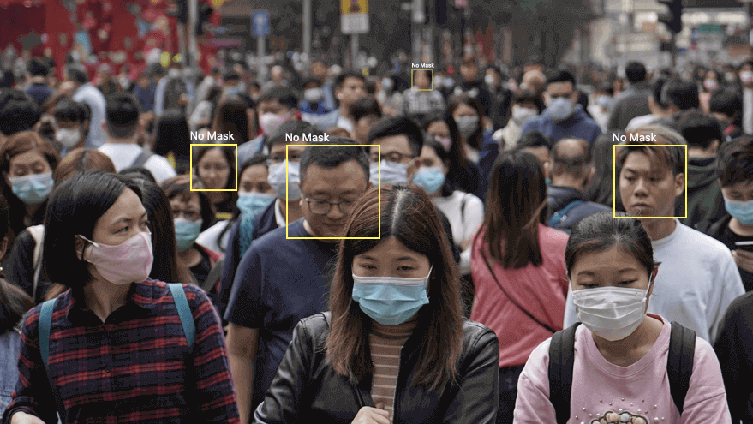
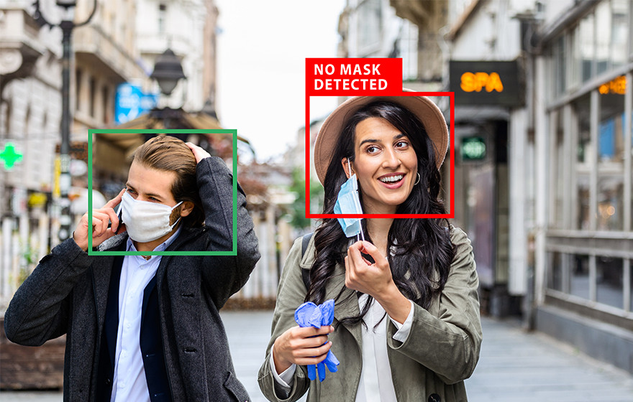

Slide 9
TECH TOOLS

Slide 10
TOOLS
LANGUAGE - PYTHON
OPENCV
TENSORFLOW
GOOGLE COLAB

Slide 11

Python is an interpreted, object-oriented, high-level programming language with dynamic semantics. Its high-level built in data structures, combined with dynamic typing and dynamic binding, make it very attractive for Rapid Application Development, as well as for use as a scripting or glue language to connect existing components together.

Slide 12

OpenCV (Open Source Computer Vision Library) is an open source computer vision and machine learning software library. OpenCV was built to provide a common infrastructure for computer vision applications and to accelerate the use of machine perception in the commercial products. Being a BSD-licensed product, OpenCV makes it easy for businesses to utilize and modify the code.

Slide 13

TensorFlow is a Python-friendly open source library for numerical computation that makes machine learning faster and easier.

Slide 14

Google colab
Google colab/colaboratory is a product from Google Research. It allows anybody to write and execute arbitrary python code through the browser, and is especially well suited to machine learning, data analysis and education.

Slide 15
WORKING

Slide 16
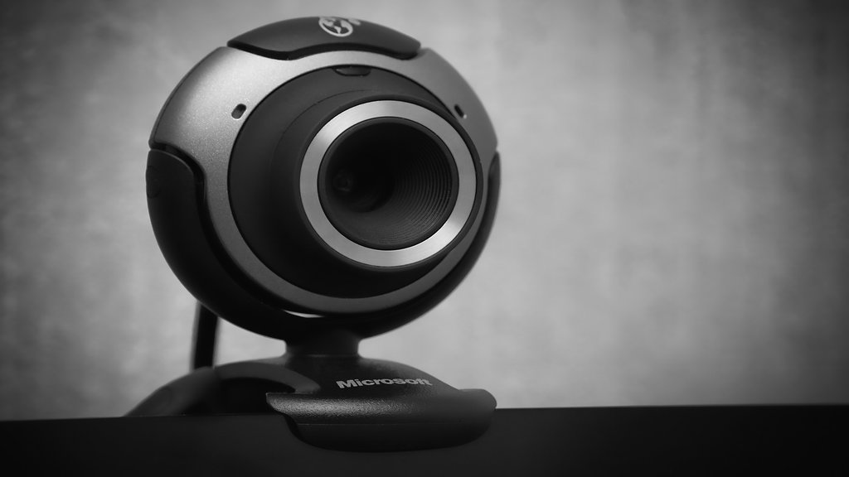
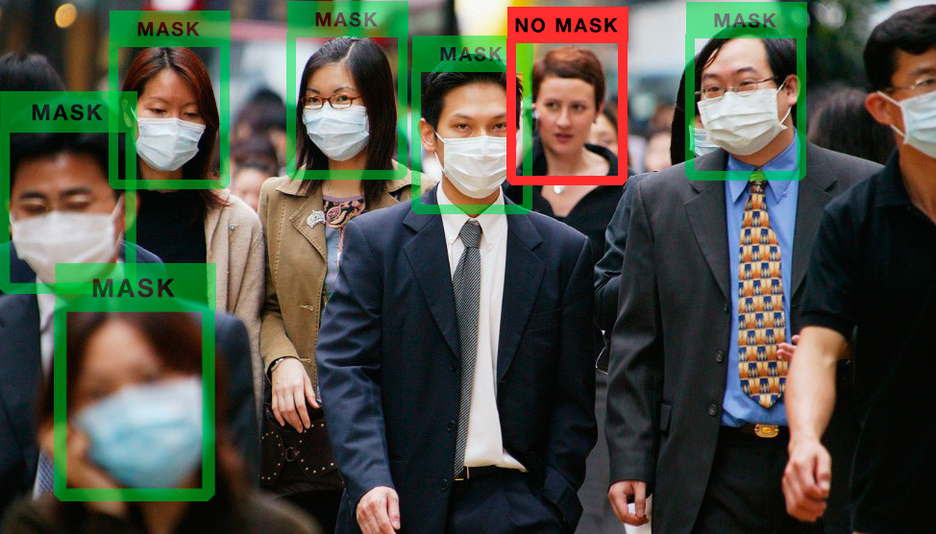
CAPTURING AND PROCESSING IMAGES
DETECTING FACES
WEBCAM/CAMERA
MODEL
RESULT

Slide 17
Progress report
IMAGE PROCESSING & DATA PREPARATION
MODEL MAKING : >> MODEL_0
>>MODEL_1
>>MODEL_2
>>MODEL_3
3. OUTPUT

Slide 18
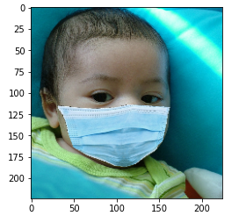
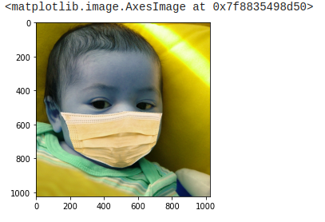
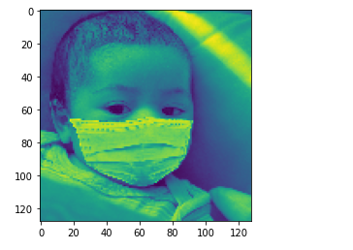
IMAGE PROCESSING & DATA PREPARATION
MODIFIED IMAGE (RGB)
SIZE = 224 x 224
ORIGINAL IMAGE
SIZE = 1024 x 1024
MODIFIED IMAGE (GRAY SCALE)
SIZE = 128 x 128

Slide 19
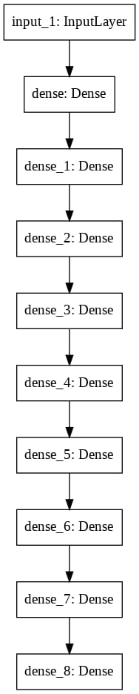
MODEL MAKING
NAME – MODEL_0
TEST ACCURACY – 86%

Slide 20
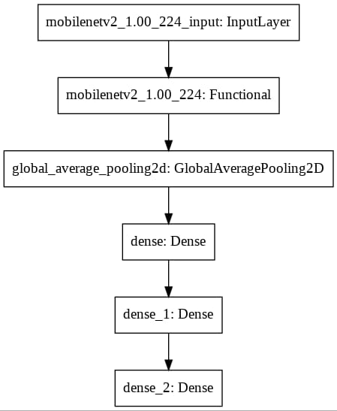
MODEL MAKING
NAME – MODEL_1
TEST ACCURACY – 97%

Slide 21
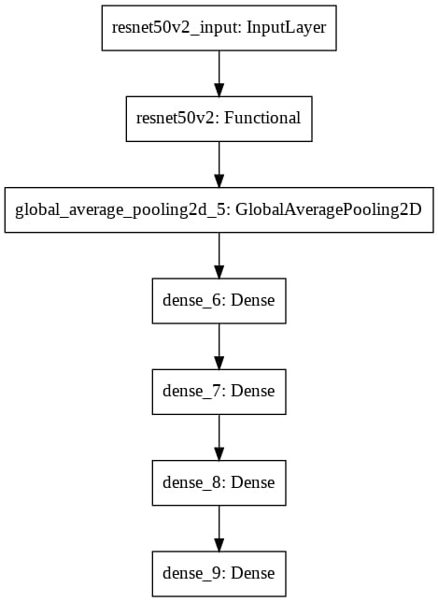
MODEL MAKING
NAME – MODEL_2
TEST ACCURACY – 99%

Slide 22
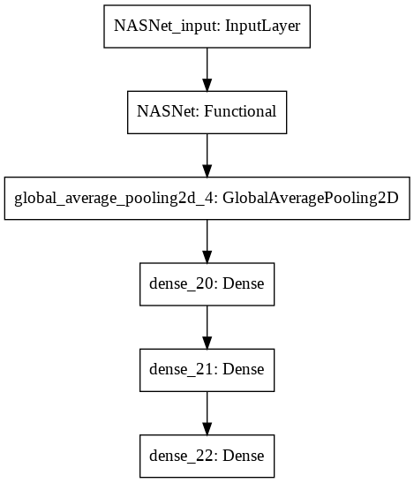
MODEL MAKING
NAME – MODEL_3
TEST ACCURACY – 84%

Slide 23
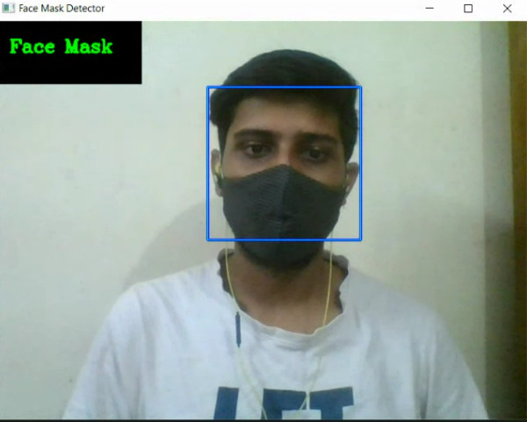
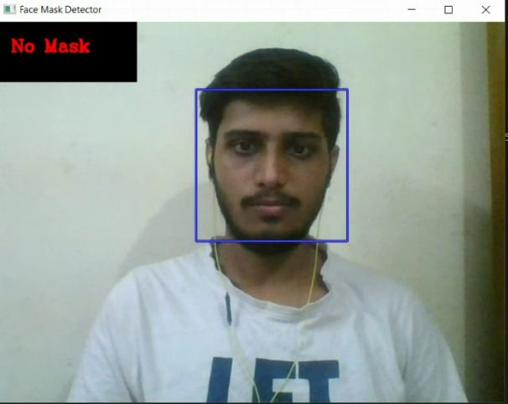
OUTPUT
So, we select model_2 which has highest accuracy of 99% and the output becomes :

Slide 24
THANK YOU

